Slide 1
Programming Fundamentals 1

Slide 2
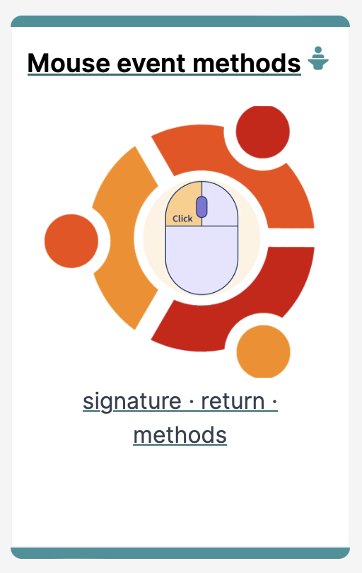
Introduction to Processing
Using Methods that handle events

Slide 3
Agenda
Method terminology:
Return type
Method names
Parameter list
Using methods to handle mouse events

Slide 4

Method Terminology

Slide 5
A SIDE NOTE
The term function is used in Processing e.g. line(), fill(), etc.
The term method is used in Java.
As this course is primarily about learning the Java language, we are planning on using the word method instead of function from now on.
BUT – they are interchangeable ☺

Slide 6
Recap: Methods in Processing
Processing comes with several pre-written methods that we can use.
A method comprises a set of instructions that performs some task.
When we invoke the method, it performs the task.
Some methods we have used already are: rect, ellipse, stroke, line, fill, etc.

Slide 7
Recap: Methods in Processing
We have also written two methods to animate our drawings:
void setup()
automatically called once when the program starts and should not be called again.
It typically sets up your display window e.g. screen size, background colour.
void draw()
automatically called straight after the setup() call.
It continuously executes the code contained inside it.

Slide 8
Method terminology
Method signature
void setup()
{
size(640, 360);
background(120);
}
Method body

Slide 9
Method signature
Return type
Method name
Parameter list
void setup()

Slide 10
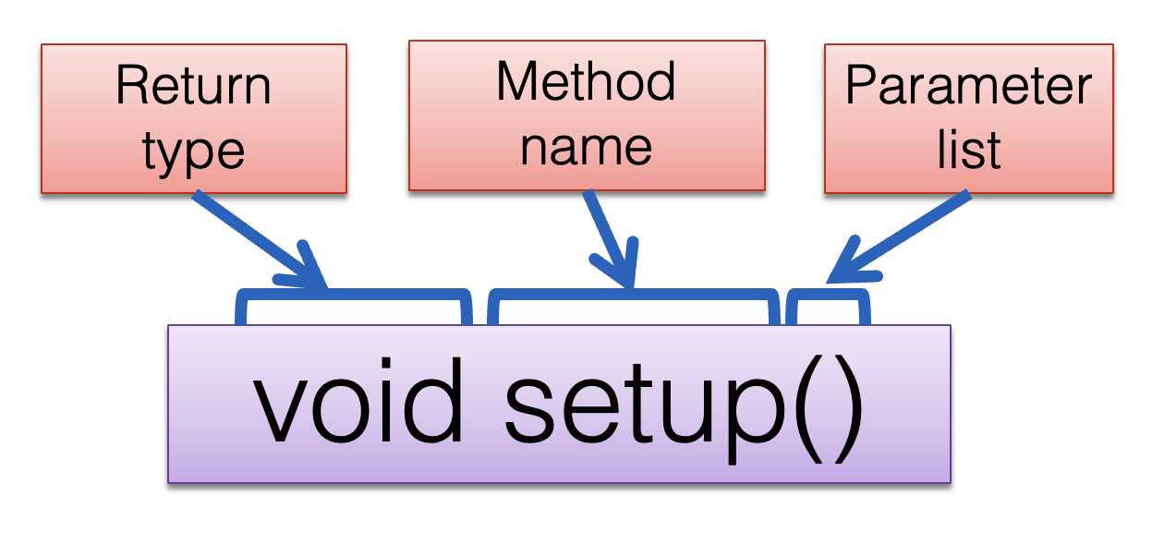
Return Type: void
Methods can return information.
The void keyword just before the method name means that nothing is returned from the method.
void is a return type and must be included in the method signature if your method returns no information.

Slide 11
Return Type: int
When a data type (e.g. int) appears before the method name, this means that something is returned from the method.
Within the body of the method, you use the return statement to return the value.

Slide 12
Return Type: int
int val = 30;
void draw()
{
int result = timestwo(val);
println(result);
}
int timestwo(int number)
{
number = number * 2;
return number;
}
// The red int in the function declaration
// specifies the type of data to be returned.
https://processing.org/reference/return.html
Notes:
Draw attention to the naming of the variables in the parameter list. The actual name of the variable does not matter…the type is all java is interested in. To demonstrate this concept, val and number are used.

Slide 13
Return Types
Methods can return any type of data e.g.
boolean
byte
char
int
float
String
etc.
You can only have one return type per method.

Slide 14
Method name
Method names should:
Use verbs (i.e. actions) to describe what the method does e.g.
calculateTax
printResults
Be mixed case with the first letter lowercase and the first letter of each internal word capitalised. i.e. camelCase

Slide 15
Parameter list
Methods take in data via their parameters.
Methods do not have to pass parameters e.g. setup() has no parameters.

Slide 16
Methods with NO parameters
Methods do not have to pass parameters.
These methods have no parameters; note how no variable is passed in the parenthesis i.e. ().
These methods don’t need any additional information to do its tasks.
void noStroke()
void setup()
void noCursor()

Slide 17
Methods with Parameters
void strokeWeight(float weight)
void size(int width, int height)
A parameter is a variable declaration –
it has a type (e.g. int) and a name (e.g. width).
If a method needs additional information to execute, we provide a parameter, so that the information can be passed into it.
The first method, strokeWeight, above has one parameter.
A method can have any number of parameters e.g. the second method, size has two

Slide 18
Mouse Event Methods

Slide 19
Mouse actions and their methods
Action | Description | Method
Clicked | Mouse button is pressed and then released | mouseClicked()
Pressed | Mouse button is pressed and held down | mousePressed()
Released | Mouse button was pressed but now released | mouseReleased()
Moved | Mouse is moved without any buttons being pressed | mouseMoved()
Dragged | Mouse is moved with a button pressed | mouseDragged()

Slide 20
Mouse methods
Mouse and keyboard events only work when a program has draw().
Without draw(), the code is only run once and then stops listening for events.
https://processing.org/reference/mousePressed_.html

Slide 21
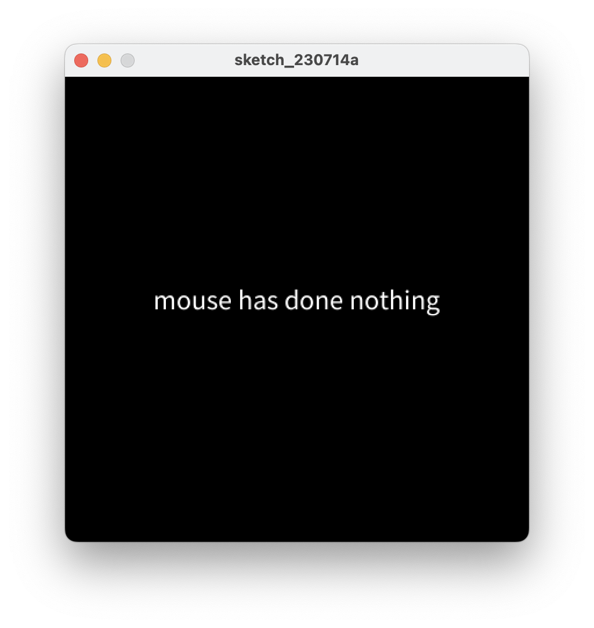
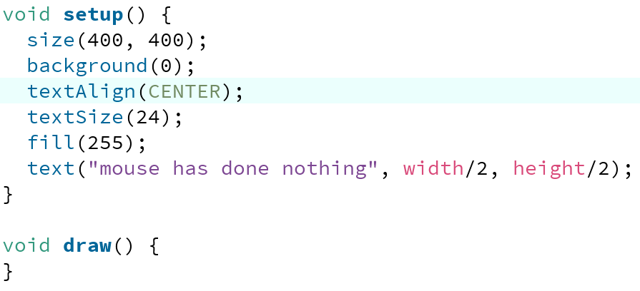
Processing Example 5.1 – setup()
Notes:
void setup() {
size(400, 400);
background(0);
textAlign(CENTER);
textSize(24);
fill(255);
text("mouse has done nothing", width/2, height/2);
}

Slide 22
Processing Example 5.1 – draw()
Based on: http://learning.codasign.com/index.php?title=Mouse_Events_in_Processing
Notes:
void setup() {
size(400, 400);
background(0);
textAlign(CENTER);
textSize(24);
fill(255);
text("mouse has done nothing", width/2, height/2);
}
void draw() {
}

Slide 23
Processing Example 5.1 – draw()
Based on: http://learning.codasign.com/index.php?title=Mouse_Events_in_Processing
Q: Why did we include the draw() method, particularly as it is empty?
Notes:
void setup() {
size(400, 400);
background(0);
textAlign(CENTER);
textSize(24);
fill(255);
text("mouse has done nothing", width/2, height/2);
}
void draw() {
}

Slide 24
Processing Example 5.1 – draw()
Based on: http://learning.codasign.com/index.php?title=Mouse_Events_in_Processing
A: draw() is required because mouse events only work when a program has it.
Notes:
void setup() {
size(400, 400);
background(0);
textAlign(CENTER);
textSize(24);
fill(255);
text("mouse has done nothing", width/2, height/2);
}
void draw() {
}

Slide 25
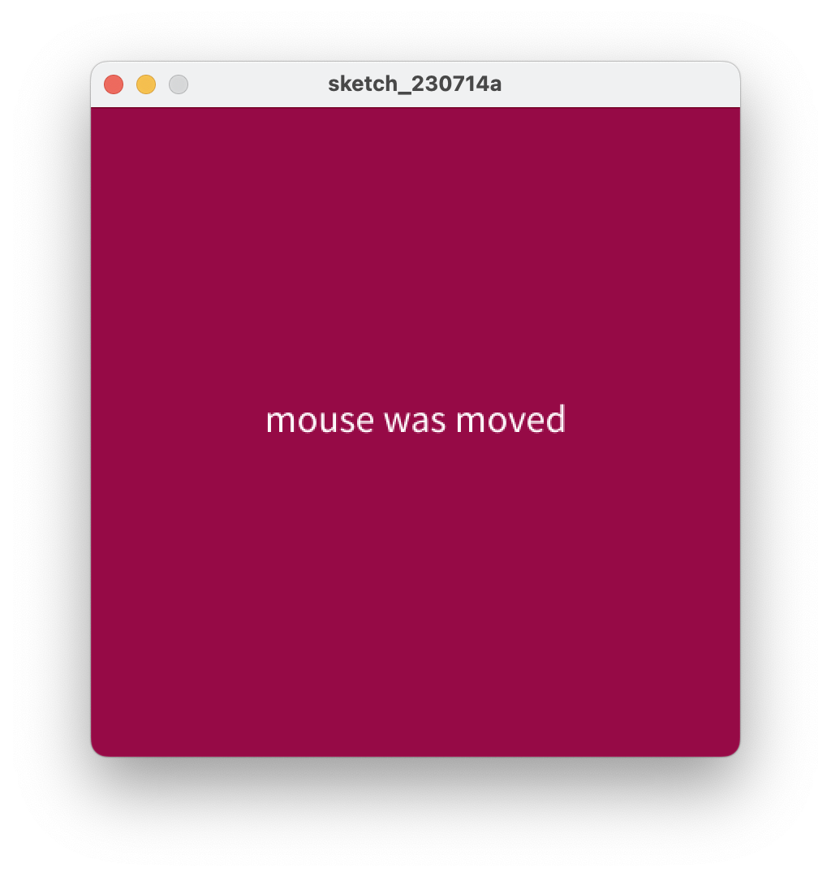
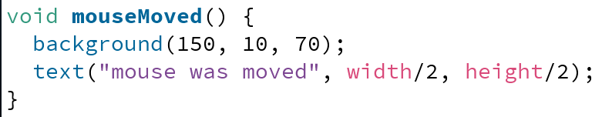
Processing Example 5.1 – mouseMoved()
Notes:
void mouseMoved() {
background(150, 10, 70);
text("mouse was moved", width/2, height/2);
}

Slide 26
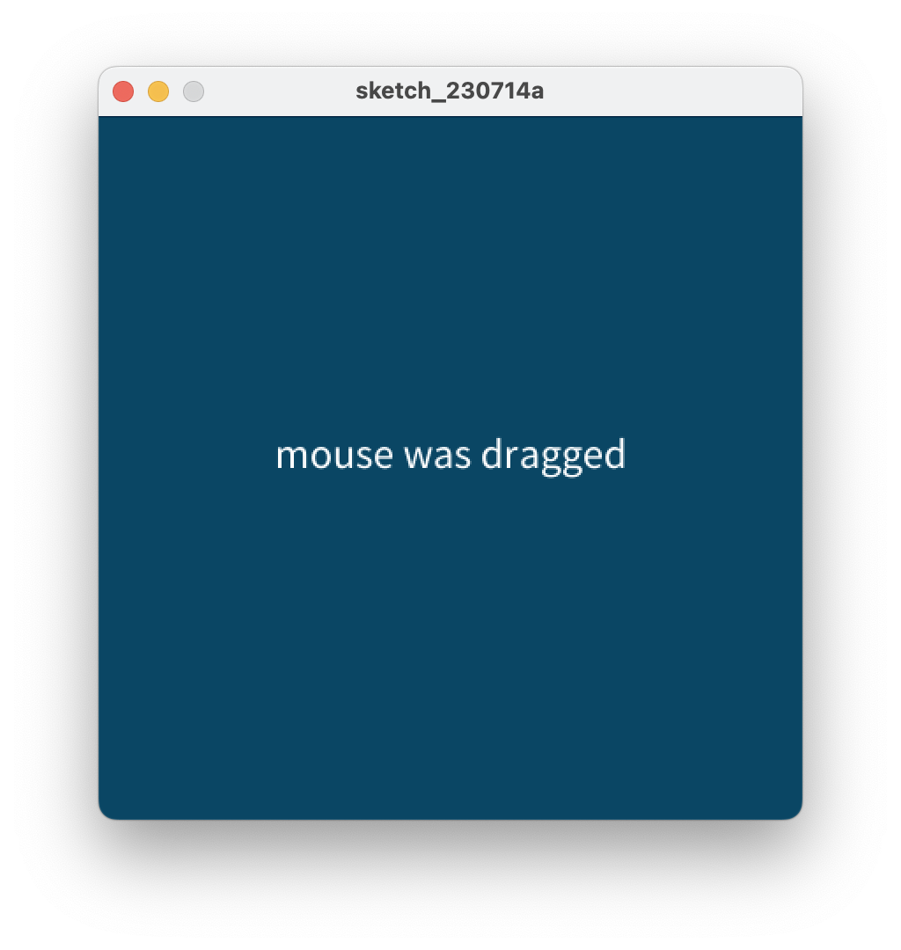
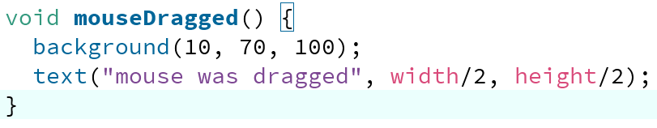
Processing Example 5.1 – mouseDragged()
Notes:
void mouseDragged() {
background(10, 70, 100);
text("mouse was dragged", width/2, height/2);
}

Slide 27
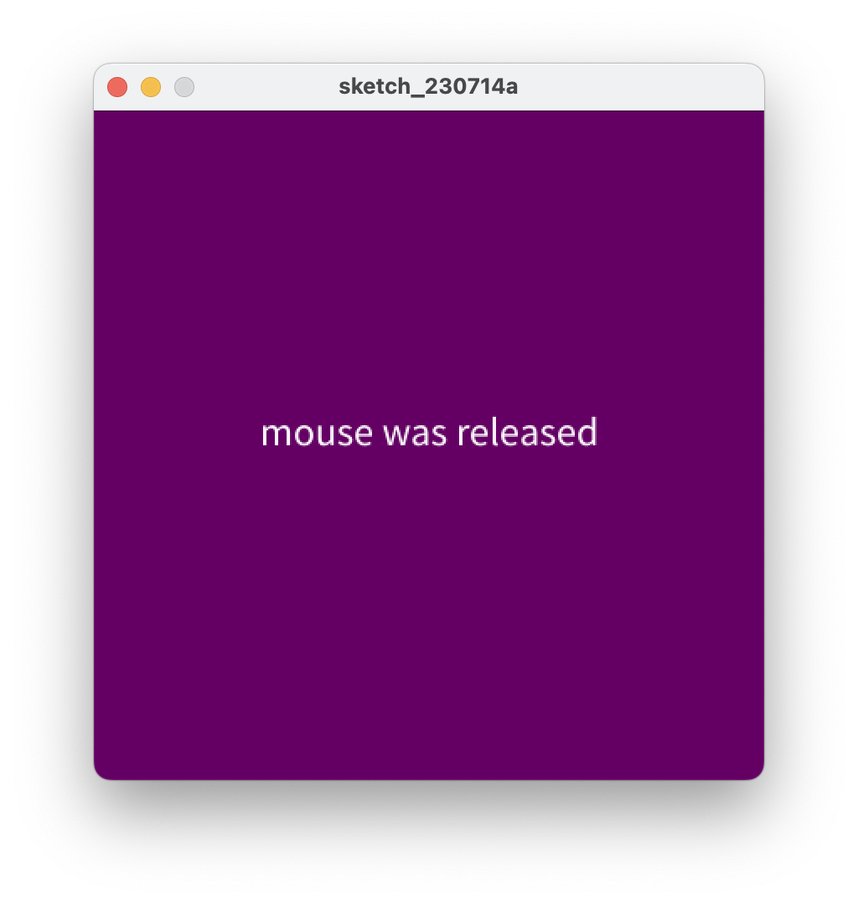
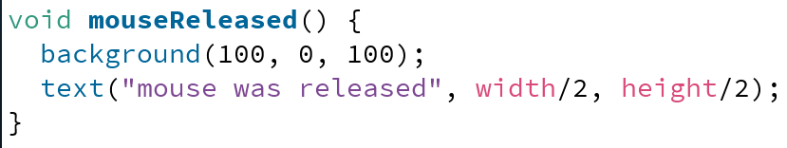
Processing Example 5.1 – mouseReleased()
Notes:
void mouseReleased() {
background(100, 0, 100);
text("mouse was released", width/2, height/2);
}

Slide 28
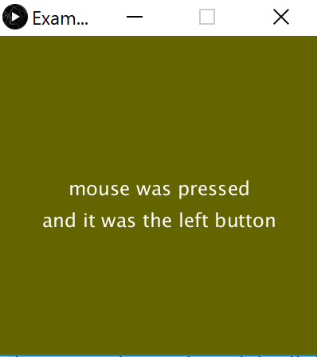
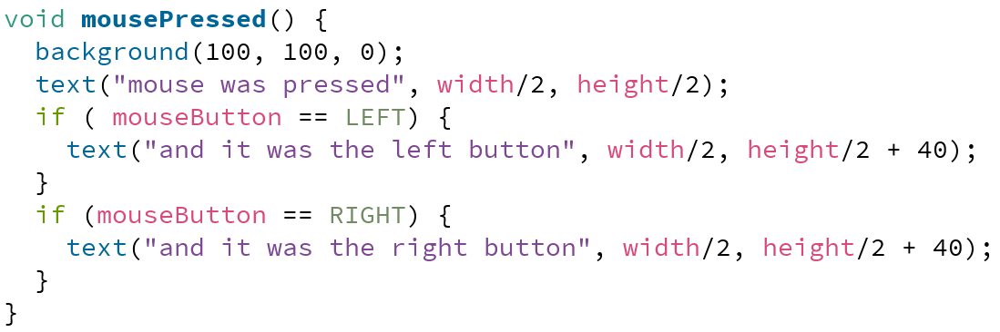
Processing Example 5.1 – mousePressed()
Notes:
void mousePressed() {
background(100, 100, 0);
text("mouse was pressed", width/2, height/2);
if ( mouseButton == LEFT) {
text("and it was the left button", width/2, height/2 + 40);
}
if (mouseButton == RIGHT) {
text("and it was the right button", width/2, height/2 + 40);
}
}

Slide 29
Some previous exercises
We will now re-work the following examples that we covered previously:
Example 3.5
Example 3.6
Example 3.7
Example 3.8
Each of these exercises tested the mousePressed variable.
Now we want them to use the mousePressed() method instead.

Slide 30
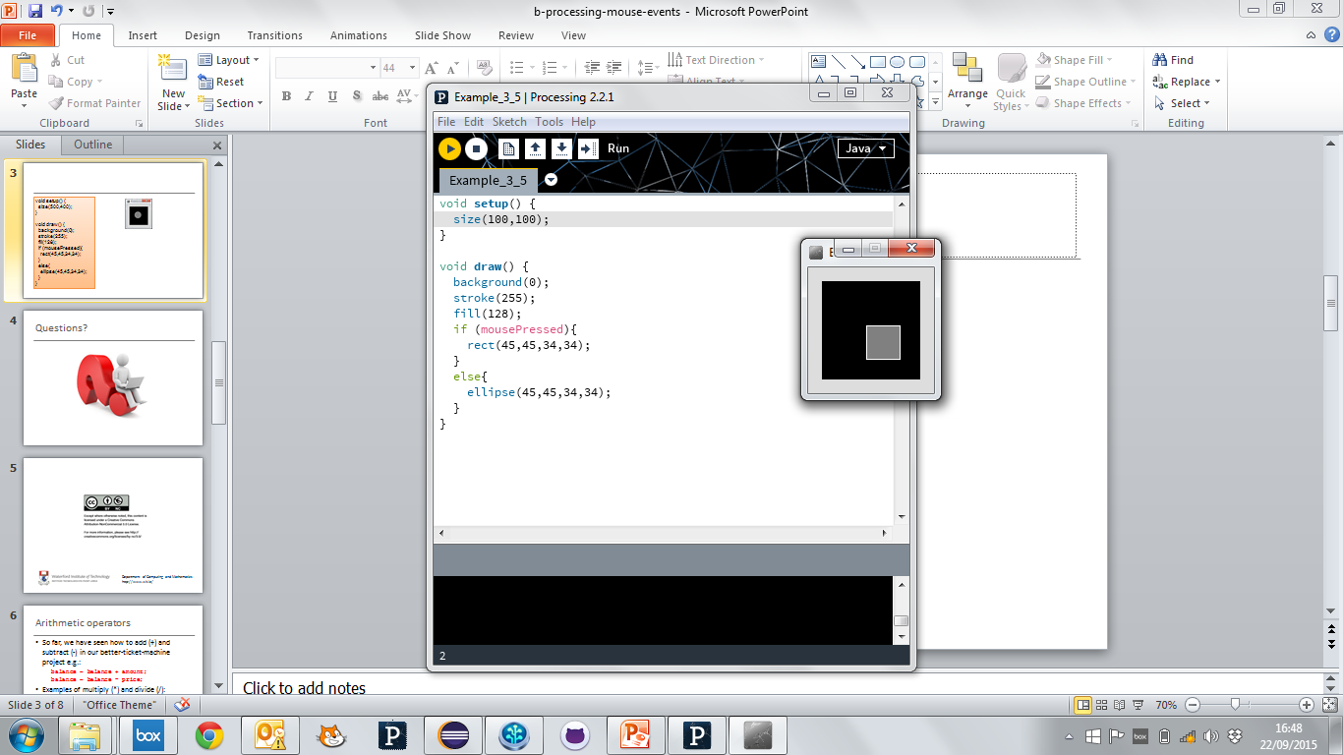
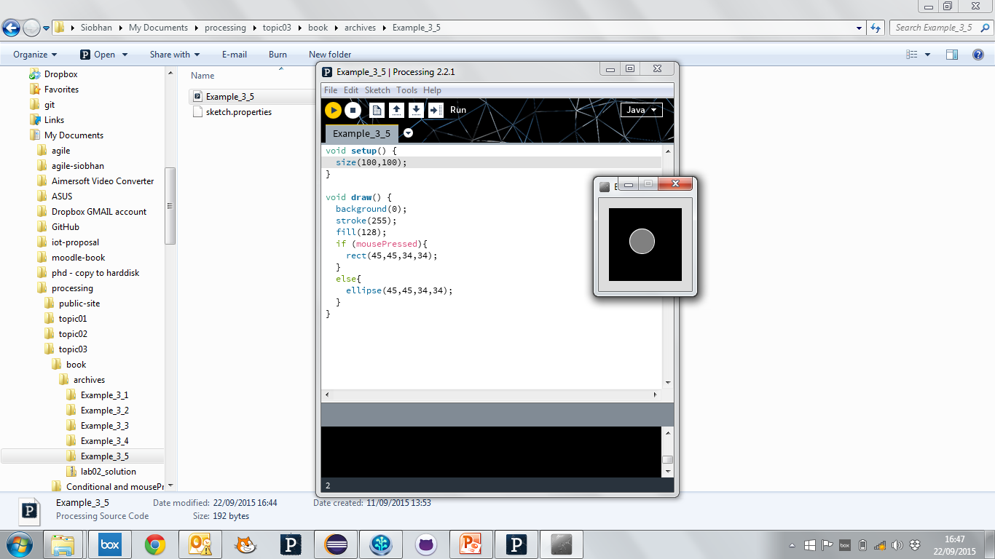
Recap: Processing Example 3.5
Functionality:
If the mouse is pressed:
draw a grey square with a white outline.
otherwise draw a grey circle with a white outline.

Slide 31
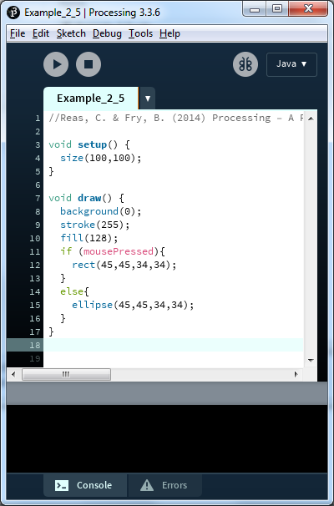
Recap: Processing Example 3.5
Notes:
//Reas, C. & Fry, B. (2014) Processing – A Programming Handbook for Visual Designers and Artists, 2nd Edition, MIT Press, London.
void setup() {
size(100,100);
}
void draw() {
background(0);
stroke(255);
fill(128);
if (mousePressed){
rect(45,45,34,34);
}
else{
ellipse(45,45,34,34);
}
}

Slide 32
Example 3.5 (v2) – mouse methods
void setup()
{
size(100,100);
stroke(255);
fill(150);
background(0);
ellipse(45,45,34,34);
}
void draw(){
}
void mousePressed(){
background(0);
rect(45,45,34,34);
}
void mouseReleased(){
background(0);
ellipse(45,45,34,34);
}

Slide 33
Before VS After
void setup() {
size(100,100);
stroke(255);
fill(150);
background(0);
ellipse(45,45,34,34);
}
void draw(){
}
void mousePressed(){
background(0);
rect(45,45,34,34);
}
void mouseReleased(){
background(0);
ellipse(45,45,34,34);
}

Slide 34
Before VS After
void setup() {
size(100,100);
stroke(255);
fill(150);
background(0);
ellipse(45,45,34,34);
}
void draw(){
}
void mousePressed(){
background(0);
rect(45,45,34,34);
}
void mouseReleased(){
background(0);
ellipse(45,45,34,34);
}

Slide 35
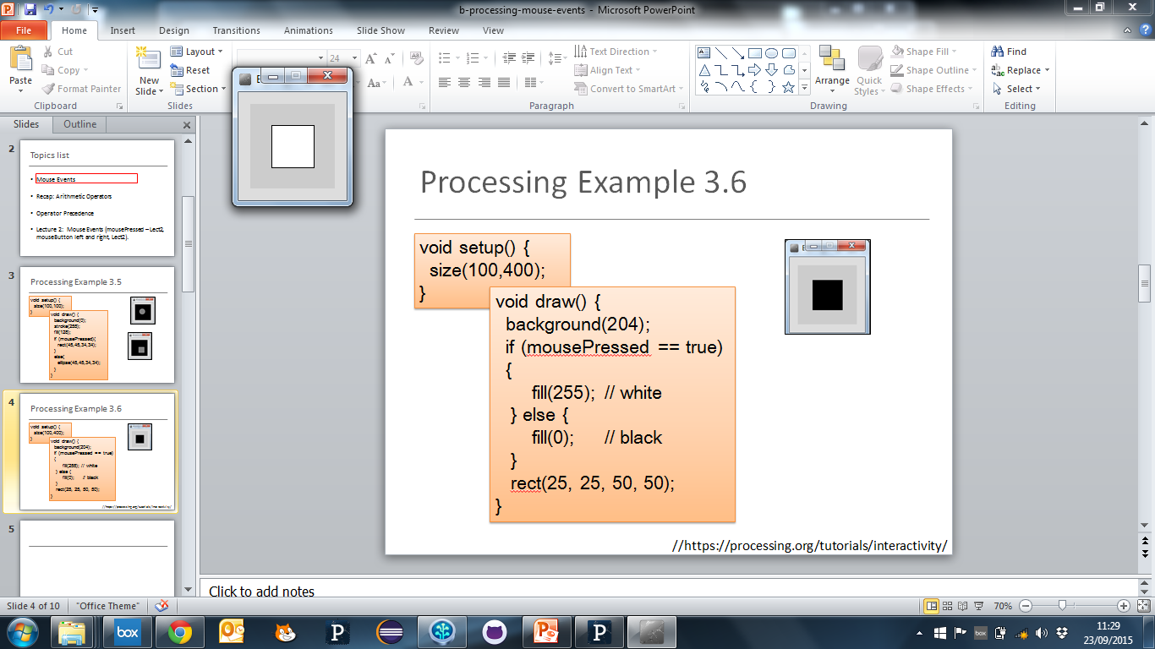
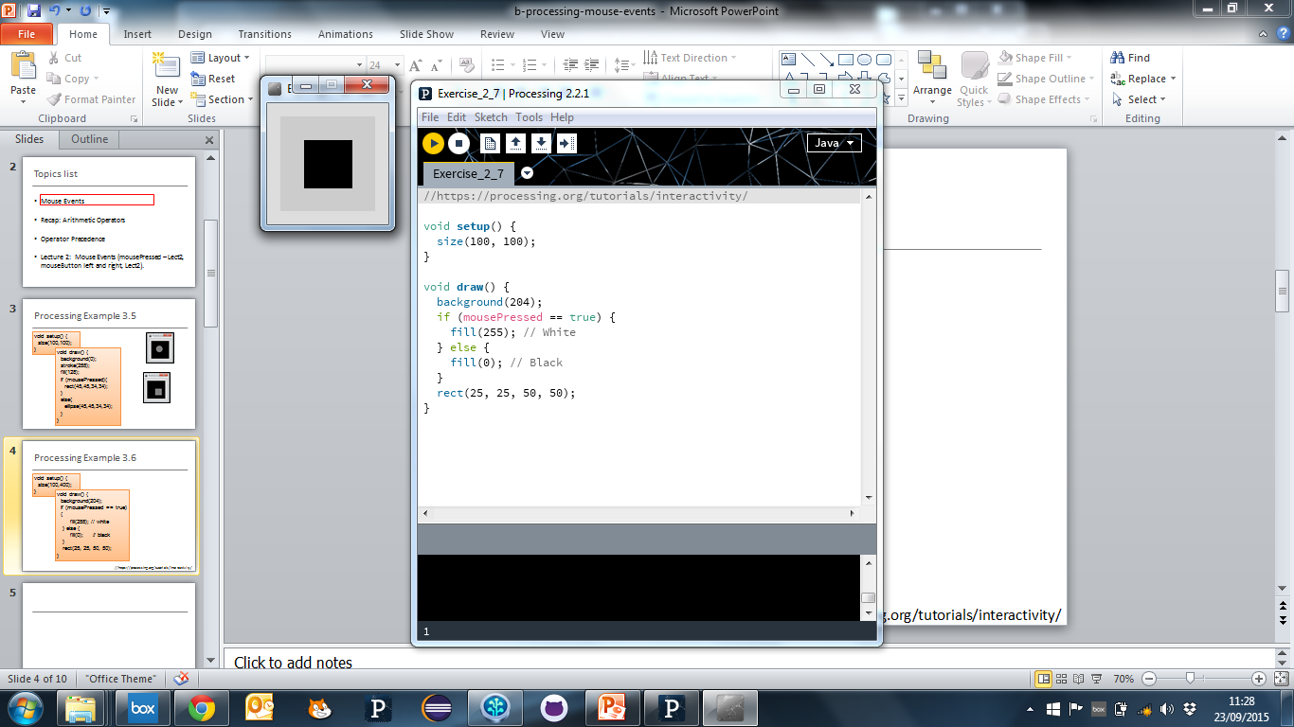
Recap: Processing Example 3.6
Functionality:
If the mouse is pressed:
set the fill to white and draw a square.
otherwise set the fill to black and draw a square.

Slide 36
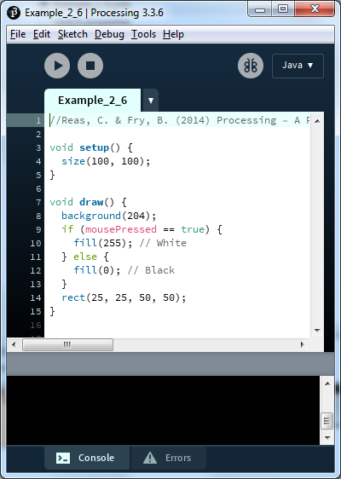
Recap: Processing Example 3.6
Notes:
//Reas, C. & Fry, B. (2014) Processing – A Programming Handbook for Visual Designers and Artists, 2nd Edition, MIT Press, London.
void setup() {
size(100, 100);
}
void draw() {
background(204);
if (mousePressed == true) {
fill(255); // White
} else {
fill(0); // Black
}
rect(25, 25, 50, 50);
}

Slide 37
Example 3.6 (v2) – mouse methods
void setup()
{
size(100,100);
background(204);
fill(0);
}
void draw(){
rect(25, 25, 50, 50);
}
void mousePressed(){
fill(255);
}
void mouseReleased(){
fill(0);
}

Slide 38
Before VS After
void setup() {
size(100,100);
background(204);
fill(0);
}
void draw(){
rect(25, 25, 50, 50);
}
void mousePressed(){
fill(255);
}
void mouseReleased(){
fill(0);
}

Slide 39
Before VS After
void setup() {
size(100,100);
background(204);
fill(0);
}
void draw(){
rect(25, 25, 50, 50);
}
void mousePressed(){
fill(255);
}
void mouseReleased(){
fill(0);
}

Slide 40
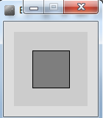
Recap: Processing Example 3.7
Functionality:
If the LEFT button on the mouse is pressed, set the fill to black and draw a square. As soon as the LEFT button is released, grey fill the square.
If the RIGHT button on the mouse is pressed, set the fill to white and draw a square. As soon as the RIGHT button is released, grey fill the square.
If no mouse button is pressed, set the fill to grey and draw a square.

Slide 41
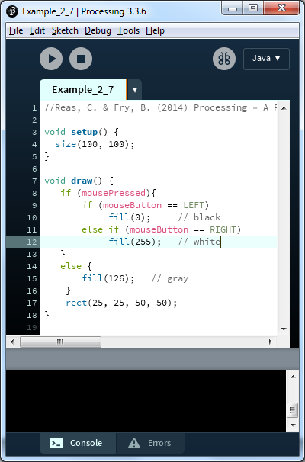
Recap: Processing Example 3.7
Notes:
//Reas, C. & Fry, B. (2014) Processing – A Programming Handbook for Visual Designers and Artists, 2nd Edition, MIT Press, London.
void setup() {
size(100, 100);
}
void draw() {
if (mousePressed){
if (mouseButton == LEFT)
fill(0); // black
else if (mouseButton == RIGHT)
fill(255); // whit
}
else {
fill(126); // gray
}
rect(25, 25, 50, 50);
}

Slide 42
Example 3.7 (v2) – mouse methods
void setup()
{
size(100,100);
background(204);
fill(126);
}
void draw(){
rect(25, 25, 50, 50);
}
void mousePressed(){
if (mouseButton == LEFT)
fill(0); // black
else if (mouseButton == RIGHT)
fill(255); // white
}
void mouseReleased(){
fill(126);
}

Slide 43
Before VS After
void setup() {
size(100,100);
background(204);
fill(126);
}
void draw(){
rect(25, 25, 50, 50);
}
void mousePressed(){
if (mouseButton == LEFT)
fill(0); // black
else if (mouseButton == RIGHT)
fill(255); // white
}
void mouseReleased(){
fill(126);
}

Slide 44
Before VS After
void setup() {
size(100,100);
background(204);
fill(126);
}
void draw(){
rect(25, 25, 50, 50);
}
void mousePressed(){
if (mouseButton == LEFT)
fill(0); // black
else if (mouseButton == RIGHT)
fill(255); // white
}
void mouseReleased(){
fill(126);
}

Slide 45
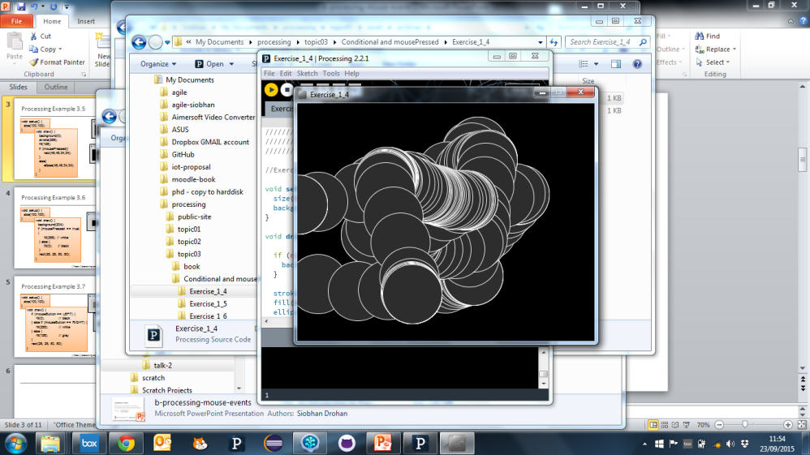
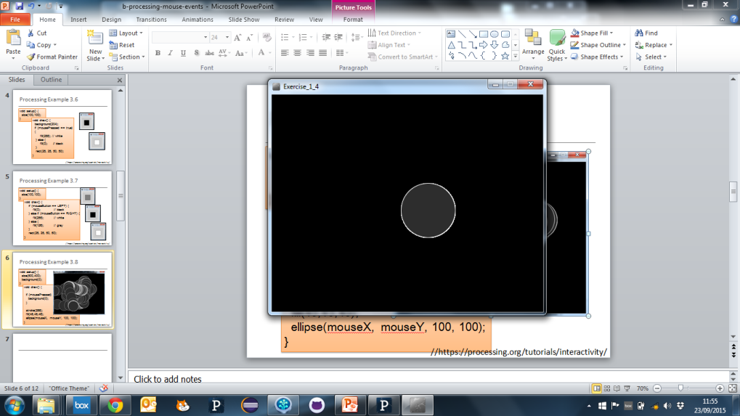
Recap: Processing Example 3.8
Functionality:
Draw a circle on the mouse (x,y) coordinates.
Each time you move the mouse, draw a new circle.
All the circles remain in the sketch until you press a mouse button.
When you press a mouse button, the sketch is cleared and a single circle is drawn at the mouse (x,y) coordinates.

Slide 46
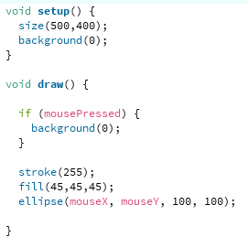
Recap: Processing Example 3.8
https://processing.org/tutorials/interactivity/
Notes:
//https://processing.org/tutorials/interactivity
void setup() {
size(500,400);
background(0);
}
void draw() {
if (mousePressed) {
background(0);
}
stroke(255);
fill(45,45,45);
ellipse(mouseX, mouseY, 100, 100);
}

Slide 47
Before VS After
void setup()
{
size(500,400);
background(0);
stroke(255);
fill(45,45,45);
}
void draw(){
ellipse(mouseX, mouseY, 100, 100);
}
void mousePressed(){
background(0);
}

Slide 48

Questions?

Slide 49
References
Reas, C. & Fry, B. (2014) Processing – A Programming Handbook for Visual Designers and Artists, 2nd Edition, MIT Press, London.

Slide 50



